Slide 1
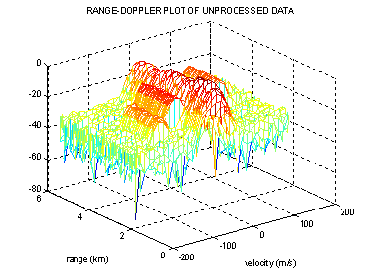

Some MATLAB Tutorials
Fundamentals of Radar Signal Processing
Dr. Mark A. Richards
School of Electrical & Computer Engineering
Georgia Institute of Technology
Atlanta, Georgia 30332-0250
mark.richards@ece.gatech.edu

Slide 2
LICENSE
Permission to use, copy, modify and distribute, including the right to grant others rights to distribute at any tier, this software and its documentation for any purpose and without fee or royalty is hereby granted, provided that the following copyright and attribution and the disclaimer (see next two pages) are retained in ALL copies and derivative works of the software and documentation, including modifications that you make for internal use or for distribution.

Slide 3
COPYRIGHT AND ATTRIBUTION
Except as otherwise noted, this software was developed by Dr. Mark A. Richards and/or Gregory Heim of the Georgia Institute of Technology, and was provided by the Georgia Institute of Technology as part of the professional education course “Fundamentals of Radar Signal Processing”, 2006 and subsequent offerings, or by Dr. Mark A. Richards to accompany the book Fundamentals of Radar Signal Processing (McGraw-Hill, New York, 2005).
Copyright 2006-2011, Mark A. Richards and/or Gregory Heim. All Rights Reserved.

Slide 4
DISCLAIMER
All software is provided "as is". It is intended for tutorial and demonstration use only and is provided as a convenience and courtesy to the user. No user support is available.
The developer, the Georgia Institute of Technology, and the Distance Learning and Professional Education division of the Georgia Institute of Technology make absolutely no warranty of merchantability or fitness for any use for any particular purpose, or that the use of the software will not infringe on any third party patents, copyrights, trademarks, or other rights.

Slide 5
Fundamentals of Radar Signal Processing (FRSP) Tutorial MATLAB Software - 1
Software is available …
On FRSP textbook support web site at www.radarsp.com
On CD-ROM for FRSP professional education course (“short course”)
Software is provided as a WinZip file titled FRSP_Demos.zip
Assumes MATLAB 6 and Signal Processing Toolbox
mainly for hamming, db functions, but may be others
Used with version R2010a

Slide 6
Fundamentals of Radar Signal Processing (FRSP) Tutorial MATLAB Software - 2
Software contains the following GUI-based MATLAB demonstrations:
RCS of Complex Targets
LFM Pulse Compression
Multi-PRF Blind Zone Calculation
… and the following non-GUI-based demonstrations
Pulse Doppler Processing
Detection Calculator
Doppler Beam Sharpening
Adaptive Beamformer
… and the following student project assignments
Pulse Doppler Processing (similar to above, in project form)
RCS (similar to above, in project form)
LFM waveform and matched filtering (similar to above, in project form)
Threshold detection

Slide 7
Software Installation
Unzip FRSP_Demos.zip in the directory of your choice
This will create a new directory called FRSP_Demos
Start MATLAB and choose the Set Path command under the File menu
Navigate to the FRSP_Demos directory and click the Add with Subfolders button
Click the Save button, and then Close
All of the FRSP demo software should now be in your MATLAB path

Slide 8
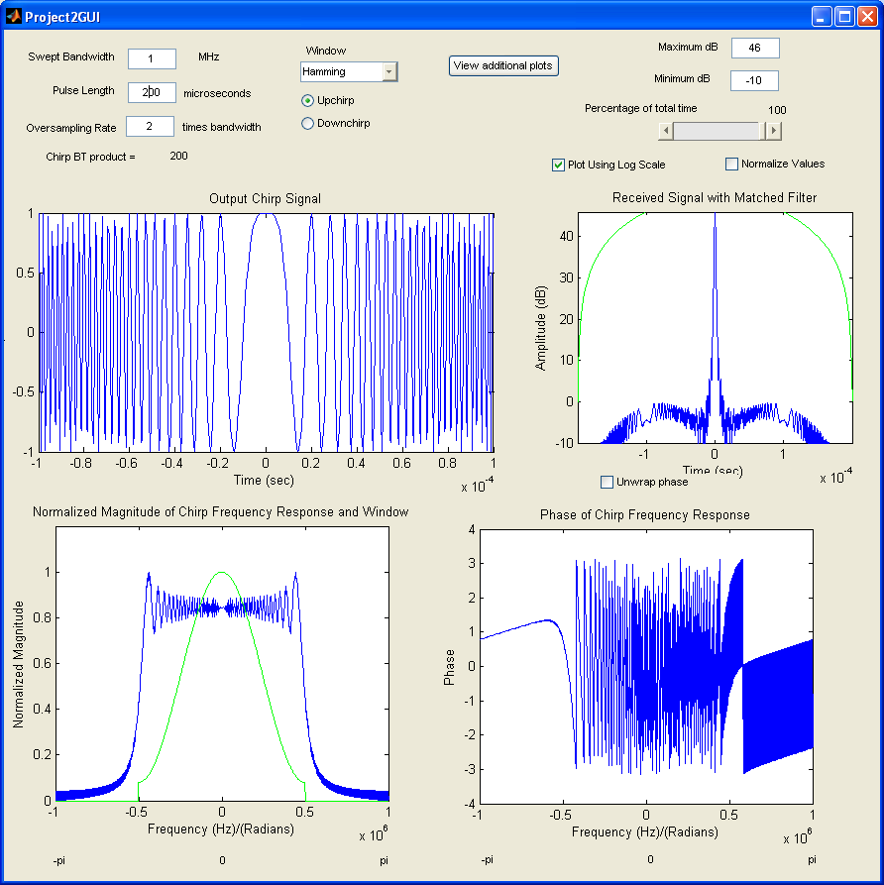
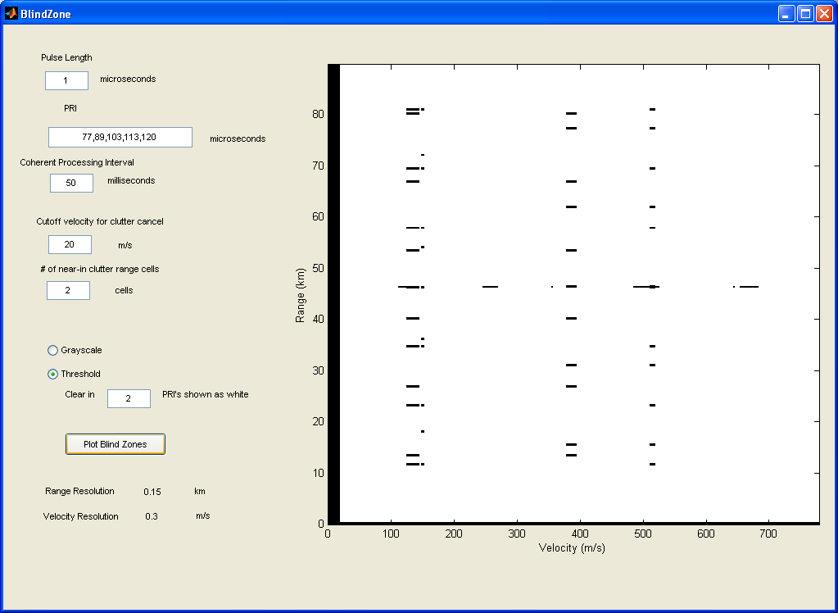
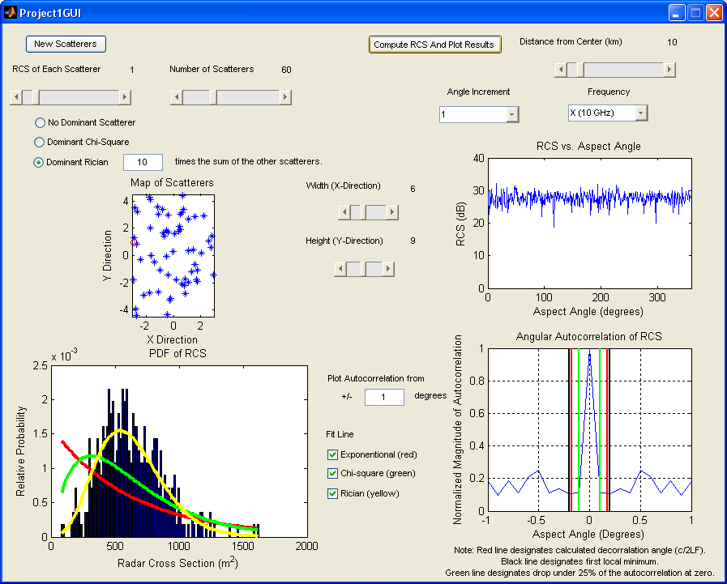
GUI-Based Demos

Slide 9
RCS: GUI-Based RCS of Complex Targets
Angle variation of RCS of “complex target” composed of “many” scatterers
With or without “dominant scatterer”
Reproduces this experiment:
Can vary # of scatterers, box size, presence/absence of dominant scatterer and relative strength
Compare to various pdfs
Compute autocorrelation lengths
>> RCS
Select/change target characteristics, then click on ‘New Scatterers’
Select/change plot options, then click on ‘Compute RCS and Plot Results’

Slide 10
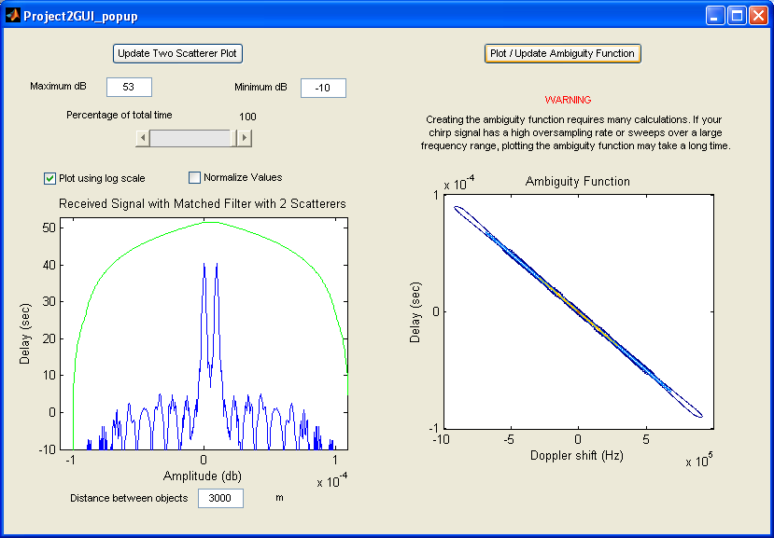
LFM: GUI-Based LFM Waveform Characteristics
Generates and analyzes LFM waveforms and corresponding matched filter outputs
Can vary pulse duration, bandwidth, sampling rate
Effects of windows
Two-scatterer resolution
>> LFM
Select/change waveform, window, plot characteristics
Plots should update automatically
Click on ‘View Additional Plots’ for two-scatterer and ambiguity plots
Caution: ambiguity function can be VERY slow and/or exhaust memory!

Slide 11
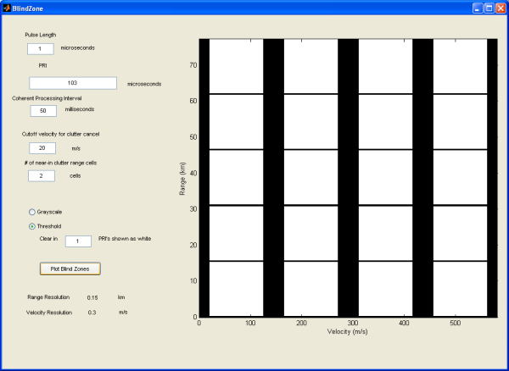
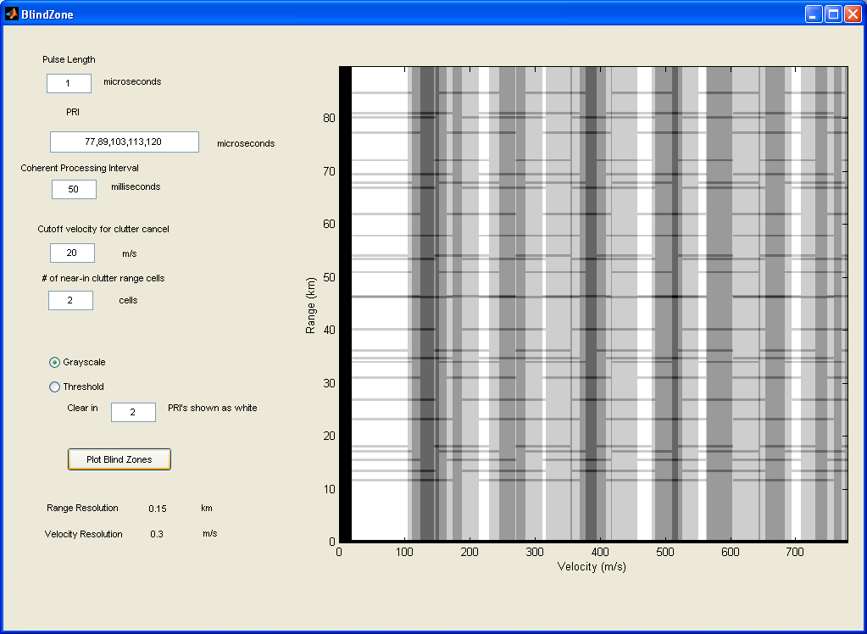
BlindZone: GUI-Based Multi-PRF Blind Zone Calculator
Computes range-Doppler blind zones for multiple PRIs and “M-of-N” detection
Can vary # and value of PRIs, and the threshold (M) for M-of-N detection
Allows for clutter spectrum width, near-in clutter eclipsing
>> BlindZone
Enter PRIs and detection threshold
Other parameters as desired
Click “Plot Blind Zones”
2-of-5 example
Single PRI
Grayscale Display Mode

Slide 12
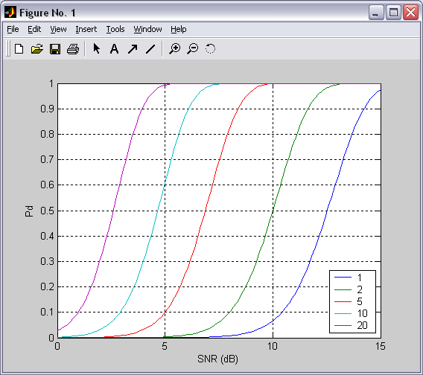
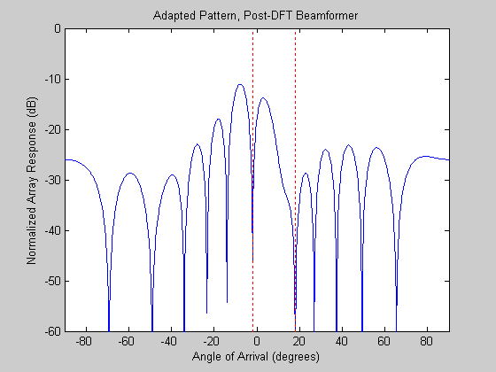
Non-GUI-Based Demos

Slide 13
Detection Calculator Pd_calc
Detection calculator that computes P_{d} for non-coherent square-law integration of Swerling target models in Gaussian I/Q noise with a square-law detector
Implements equations in the appendix of Radar Target Detection- Handbook of Theory and Practice by Daniel P. Meyer and Herbert A. Mayer, (Academic Press, 1973) (“M&M”)
Computes the threshold and probability of detection for the four standard Swerling cases and the nonfluctuating case
Also included is the Albersheim approximation to the nonfluctuating case.
To use: write a main program to call Pd.m
See examples on next two slides
Based on meyerfun.m, version 1.2 (by Douglas Dougherty, NSWC DD Code T45, 4/14/99)
meyerfun.m and a controlling GUI, meyer.m, available on MathWorks’ MATLAB Central file exchange, http://www.mathworks.com/matlabcentral/fileexchange/1569
Modified significantly
Additional cases, vectorization, numerical issues

Slide 14
Example Calling Program #1: Pd_as_a_function_of_N.m
% M file for computing a figure to illustrate the effect of
% noncoherent integration on Pd vs. SNR for Swerling 0,
% for Pfa = 1e-8, SNR from -2 to+15 dB, and N=1 to 100.
%
% Mark Richards
% July 2002
SNR_dB = linspace(0,15);
Pfa = 1e-8*ones(size(SNR_dB));
% Step through the cases:
Pd0 = Pd(1*ones(size(SNR_dB)),Pfa,SNR_dB,0);
Pd1 = Pd(2*ones(size(SNR_dB)),Pfa,SNR_dB,0);
Pd2 = Pd(5*ones(size(SNR_dB)),Pfa,SNR_dB,0);
Pd3 = Pd(10*ones(size(SNR_dB)),Pfa,SNR_dB,0);
Pd4 = Pd(20*ones(size(SNR_dB)),Pfa,SNR_dB,0);
% OK, now draw the results
plot(SNR_dB,[Pd0; Pd1; Pd2; Pd3; Pd4])
axis([0,15,0,1]);
xlabel('SNR (dB)'); ylabel('Pd'); grid;
legend('N=1','N=2','N=5','N=10','N=20','Location','SouthEast');

Slide 15
Example Calling Program #1: Swerling_compare.m
% M file for computing a figure to compare the 5 swerling cases + Albersheim
% for N=10 pulses, Pfa = 1e-8, and SNR from -2 to+15 dB
%
% Mark Richards
% July 2002
SNR_dB = linspace(-2,15);
Pfa = 1e-8*ones(size(SNR_dB));
N = 10*ones(size(SNR_dB));
% Step through the cases:
Pd0 = Pd(N,Pfa,SNR_dB,0); % nonfluctuating; also called Swerling 0 or 5 in some cases
Pd1 = Pd(N,Pfa,SNR_dB,1);
Pd2 = Pd(N,Pfa,SNR_dB,2);
Pd3 = Pd(N,Pfa,SNR_dB,3);
Pd4 = Pd(N,Pfa,SNR_dB,4);
Pd6 = Pd(N,Pfa,SNR_dB,6); % Albersheim's equation
% OK, now draw the results
plot(SNR_dB,[Pd0; Pd1; Pd2; Pd3; Pd4]; Pd6)
axis([-2,15,0,1]);
xlabel('SNR (dB)'); ylabel('Pd'); grid;
legend('Nonfluctuating','Swerling 1','Swerling 2','Swerling 3', ...
'Swerling 4','Albersheim','Location','Southeast');

Slide 16
Pulse Doppler Processing Demonstration
Formation of a fast-time/slow-time (range/pulse #) data matrix for moving targets in noise and clutter
LFM chirp waveform
Pulse Doppler processing for target detection; and range, velocity, and relative RCS estimation
Formation of range-Doppler matrix
Pulse compression
MTI filter compensation
R⁴ correction
Threshold detection
Peak interpolation

Slide 17
Pulse Doppler Processing Procedure
Two stages
makePDdata creates a fast-time/slow-time data matrix that will support the desired scenario
procPDdata performs the processing
Stage 1: Data Creation
>> edit makePDdata
Set all simulation parameters by editing input section of makePDdata.m
>> makePDdata
To create data set for processing
Output in file.mat
Where file is the “root file name” you specify
Parameters logged in file.lis
Stage 2: Processing
>> procPDdata

Slide 18
Pulse Doppler Processing Inputs
makePDdata user input section:
% User Input Section ###############################
% ###############################################
% Get root file name for saving results
file=input('Enter root file name for data and listing files: ','s');
T = 10e-6; % pulse length, seconds
W = 10e6; % chirp bandwidth, Hz
fs = 12e6; % chirp sampling rate, Hz; oversample by a little
Np = 20; % # of pulses
jkl = 0:(Np-1); % pulse index array
PRF = 25.0e3; % PRF in Hz
PRI = (1/PRF); % PRI in sec
T_0 = PRI*jkl; % relative start times of pulses, in sec
g = ones(1,Np); % gains of pulses
T_out = [12 38]*1e-6; % start and end times of range window in sec
T_ref = 0; % system reference time in usec
fc = 10e9; % RF frequency in Hz; 10 GHz is X-band
% Compute unambiguous Doppler interval in m/sec
% Compute unambiguous range interval in meters
vua = 3e8*PRF/(2*fc);
rmin = 3e8*T_out(1)/2;
rmax = 3e8*T_out(2)/2;
rua = rmax-rmin;
% Define number of targets, then range, amplitude, and
% radial velocity of each
Ntargets = 4;
del_R = (3e8/2)*( 1/fs )/1e3; % in km
ranges = [2.3 2.7 3.1 3.5]*1e3; % in km
SNR = [10 20 15 20]; % dB
vels = [-0.3 -0.15 +0.1 +0.25]*vua; % in m/sec
% End User Input Section #########################
% ############################################

Slide 19
Pulse Doppler Processing Outputs - 1

Slide 20
Pulse Doppler Processing Outputs - 2

Slide 21
Pulse Doppler Processing Outputs - 3

Slide 22
Doppler Beam Sharpening Imaging - 1
Closely related to the pulse Doppler demonstration and project
Imaging of a user-specified array of point scatterers
Two stages
makeSARdata creates a fast-time/slow-time data matrix that will support the desired scenario
procSARdata_DBS performs the DBS imaging algorithm
Stage 1: Data Creation
>> edit makeSARdata
Set all simulation parameters by editing input section of makeSARdata.m
>> makeSARdata
To create data set for processing
Output in file.mat
Where file is the “root file name” you specify
Parameters logged in file.lis

Slide 23
Doppler Beam Sharpening Imaging - 2
Stage 2: Image Formation
>> edit procSARdata_DBS
Set image formation option switches by editing input section of procSARdata_DBS.m
>> procSARdata_DBS to generate DBS image
Range-compressed only in Fig. 1 window
Fully-formed image in Fig. 2 window
If geometric corrections selected, then
Cross-range resampled image in Fig. 3 window
Range curvature-corrected image in Fig. 4 window

Slide 24
DBS Demonstration: makeSARdata
% User input section #################################
% need a file name to store data, e.g. 'myfile' or 'temp' or 'sardata'.
% Data will then be in 'myfile.dat', etc.
file=input('Enter root file name for data and listing files: ','s');
DCR = 20; % cross-range resolution, m
DR = 20; % range resolution, m
Rcrp = 40000; % range to swath center
v = 150; % platform velocity, m/s
fc = 10e9; % RF frequency in Hz
lambda = c/fc; % wavelength, m
tau = 5e-6; % pulse length, seconds (bandwidth set by resolution)
Daz = 0.2; % antenna azimuth size, m
thetaaz = lambda/Daz; % azimuth beamwidth, radians
BWdopp = 2*v/lambda*thetaaz; % slow time Doppler bandwidth, Hz
Ls = 3000; % swath depth, m
oversample_st = 2; % slow time oversample factor; higher makes
% prettier pictures but larger data sets
oversample_ft = 2; % fast time oversample factor, similar to slow time
% Define target locations, one row of (x,R) coordinates per target
% Ranges are relative to the CRP range (Rcrp) above.
% coords = [0,0]; % a single point target at the CRP
coords = ... % a grid of 9 point targets
[-1000,-1000;
-1000,0;
-1000,+1000;
0,-1000;
0,0;
0,+1000;
+1000,-1000;
+1000,0;
+1000,+1000];
% End user input section #####################################
% ###################################################

Slide 25
Sample makeSARdata Output

Slide 26
DBS Demonstration: procSARdata_DBS
%#######################################################
% User input section ###################################
% algorithm control parameters
dechirp = false; % use azimuth dechirp step or not
oversample_freq = 2; % oversampling in Doppler; bigger makes better
% picture but needs more memory and time
fix_geometry = false; % perform geometric corrections or not
% Get data file name
file=input('Enter root file name for data file: ','s');
% End user input section ###############################
% ######################################################

Slide 27
Sample procSARdata_DBS Output, No Geometric Corrections

Slide 28
Sample procSARdata_DBS Output with Geometric Corrections

Slide 29
Sample procSARdata_DBS Images, with and without Azimuth Dechirp
Azimuth dechirp not needed if
Consider R = 40 km, λ = 3 cm, ΔCR = 5 m
Violates limit, which is about 17 m in this case
Generate new data with ΔCR = 5 m, etc.
Process with requency oversample = 4 for good mainlobe definition
No Azimuth Dechirp: Cross-Range Smearing
With Azimuth Dechirp: Cross-Range Resolution Goal Met

Slide 30
Adaptive Beamformer
Simple demonstration of four different beamformer patterns in an environment with two jammers
Non-adaptive (fixed) beamformer
fully-adaptive beamformer using weights
“distortionless” beamformer
Post-DFT (beamspace) beamformer
>> edit beamform
Set all parameters by editing input section of beamform.m
RF, jammer AOAs, powers
Array parameters
Use -30 dB Taylor weighting (or not)
>> beamform
Four different patterns in four figure windows

Slide 31
Adaptive Beamformer beamform
%%%%%%%%%%%%%%%%%%%%%%%%%%%%%%%%%%%%%%%%%%%%%%%%%%%%%%
% User Input Section
lambda = 0.03; % wavelength
d = lambda/2; % element spacing
dl = d/lambda;
N = 16; % # of array elements
aoa_max = asin(1/2/dl); % maximum "real space" AOA (radians)
window_on = false; % true or false
Nangle = 1000; % # of angles for evaluating beam pattern
Nm1 = Nangle-1;
t_aoa = pi/180*(0); % target AOA (radians)
j_aoa1 = pi/180*(18); % jammer #1 AOA (radians)
j_aoa2 = pi/180*(-33); % jammer #2 AOA (radians)
SNR = 0; % signal to noise ratio (dB)
JSR1 = +50; % jammer #1 to noise ratio (dB)
JSR2 = +30; % jammer #2 to noise ratio (dB)
% End user input section
%%%%%%%%%%%%%%%%%%%%%%%%%%%%%%%%%%%%%%%%%%%%%%%%%%%%%%

Slide 32
Outputs from beamform, Both Jammers in the Sidelobes, No Weighting

Slide 33
Outputs from beamform, One Jammer in the Mainlobe , No Weighting

Slide 34
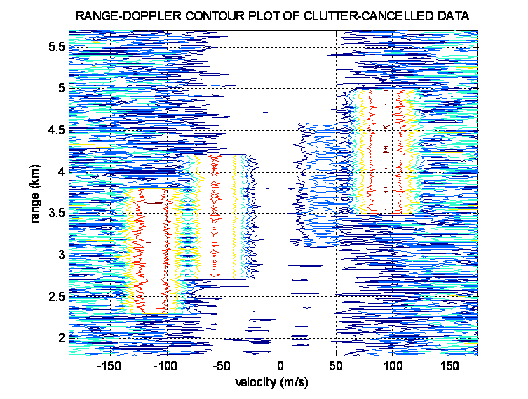
Student Projects
60
50
40
power
30
20
10
0
0
50
100
150
200
250
300
350
400
sample

Slide 35
Student Projects - 1
“Student projects” are simulation projects intended to illustrate radar signal behavior and/or teach students to implement simple signal processing algorithms
Included are four project topics
RCS statistics
Linear FM waveform properties and matched filtering
Pulse Doppler processing and detection
CFAR detection
For each project, the following are provided:
Example problem assignment in Microsoft Word format
Example problem solution consisting of
Sample MATLAB code
Microsoft Word document describing the solution

Slide 36
Student Projects - 2
Document note for all projects: Equations in the problem assignment and solution documents were created in MathType™. MathType is an upgrade to Microsoft’s Equation Editor. It can edit equations created in Equation Editor, however, the converse is not true. In addition, MathType may use some fonts or characters not available on machines on which it is not installed. Consequently, it is recommended that the user install MathType if it is desired to work with the student project assignment and solution documents. MathType is available at www.dessci.com/en/products/mathtype/.

Slide 37
Student Projects - 3
All projects are self-contained and self-explanatory using the problem assignment document, except for the pulse Doppler project
The pulse Doppler project requires that data be generated by the instructor, to be analyzed by the students.
The following charts provide some additional detail on creating data for the pulse Doppler project and then using that data in the sample solution.

Slide 38
MTI + Pulse Doppler Processing
Place all files in the Pulse Doppler directory in the MATLAB work directory
Or anywhere on the MATLAB path
>> edit makedata
Set all parameters by editing input section of makedata.m
Includes noise, clutter, moving targets, and R⁴
Radar parameters: RF, PRF, range window
Target SNR, ranges, velocities, #of targets
CNR
>> makedata
To create data set for processing
Output data in file.mat
Where file is the “root file name” you specify
Parameters logged in file.lis
>> procdata
To perform MTI + pulse Doppler processing, generate displays
Input is in same file.mat specified in makedata
Program pauses at every graph; hit any key to continue

Slide 39
Create PD Data: makedata
% User Input Section ####################################
% ####################################################
% Get root file name for saving results
file=input('Enter root file name for data and listing files: ','s');
T = 10e-6; % pulse length, seconds
W = 10e6; % chirp bandwidth, Hz
fs = 12e6; % chirp sampling rate, Hz; oversample by a little
Np = 20; % # of pulses
jkl = 0:(Np-1); % pulse index array
PRF = 25.0e3; % PRF in Hz
PRI = (1/PRF); % PRI in sec
T_0 = PRI*jkl; % relative start times of pulses, in sec
g = ones(1,Np); % gains of pulses
T_out = [12 38]*1e-6; % start and end times of range window in sec
T_ref = 0; % system reference time in usec
fc = 10e9; % RF frequency in Hz; 10 GHz is X-band
% Compute unambiguous Doppler interval in m/sec
% Compute unambiguous range interval in meters
vua = 3e8*PRF/(2*fc);
rmin = 3e8*T_out(1)/2;
rmax = 3e8*T_out(2)/2;
rua = rmax-rmin;
% Define number of targets, then range, amplitude, and
% radial velocity of each
Ntargets = 4;
del_R = (3e8/2)*( 1/fs )/1e3; % in km
ranges = [2.3 2.7 3.1 3.5]*1e3; % in km
SNR = [10 20 15 20]; % dB
vels = [-0.3 -0.15 +0.1 +0.25]*vua; % in m/sec
% End User Input Section ###############################
% #############################################

Slide 40
Final Output from makedata

Slide 41
Process PD Data: procdata
No parameters to set
Some sample figures:

Slide 42
Missing Pieces?
Contact Mark Richards by e-mail, mark.richards@ece.gatech.edu

